Slide 1


SMART INDIA HACKATHON 2024
Problem Statement ID – SIH1528
Problem Statement Title- Student Innovation
Theme- Miscellaneous
PS Category- Hardware
Team ID-
Team Name (THE SENSORS)

Slide 2

IOT BASED WOMEN SAFETY DEVICE
THE SENSORS
Proposed Solution:
A or portable device integrated with GPS, GSM, camera, panic button, and a non-lethal high-voltage generator for self-defense.
Captures video footage when triggered and uploads it directly to Google Drive for real-time evidence collection.
Sends location and emergency alerts to predefined
contacts.
Shock feature deters attackers and provides an immediate safety measure.
How It Addresses the Problem:
Provides real-time location tracking, instant alerts, and evidence gathering during an emergency.
Combines preventive and protective measures portable format.
Innovation and Uniqueness:
First-of-its-kind combination of cloud storage (Google Drive) with self-defense (high-voltage shock).
Real-time response system: GPS tracking, emergency alerts, and camera footage all triggered at the same time.
1

Slide 3
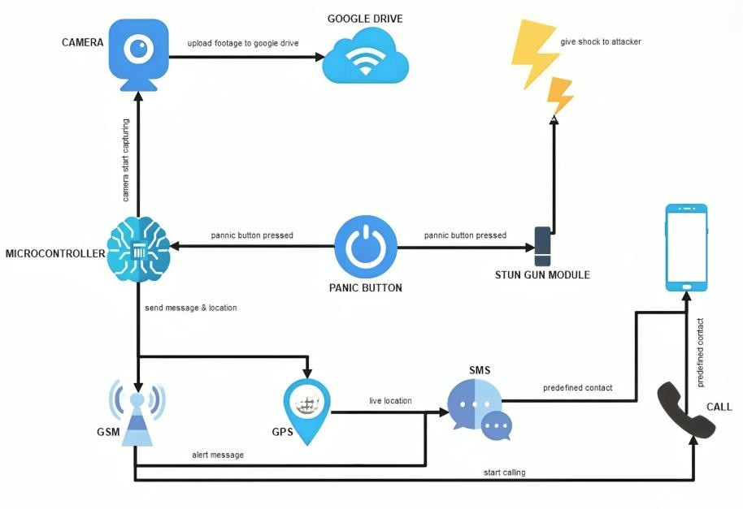
TECHNICAL APPROACH
THE SENSORS
Process Flow Architecture :
Technologies Used:
Microcontroller: The microcontroller manages and integrates all device components for coordinated, real-time operation.
GSM: Enable reliable, real-time communication and emergency alerts via SMS, even in areas without internet connectivity.
GPS: Provide precise real-time location tracking for accurate emergency response and navigation.
Google Drive API: The Google Drive API is used to securely upload and store evidence in the cloud for remote access and preservation.
Product Status:
80% product built completed and further build is on progress.
2

Slide 4
FEASIBILITY AND VIABILITY
THE SENSORS
Feasibility:
Can be prototyped using off-the-shelf components like Arduino, ESP32, and GSM/GPS modules..
Potential for mass production using custom PCB designs
and miniaturized components.
Proven availability of components (GPS, GSM, camera modules).
Cloud integration (Google Drive) is achievable via API.
Challenges:
Battery life and power consumption management..
Ensuring stable network connectivity for GSM.
Strategies:
Optimize power consumption using energy-efficient components.
Backup local storage for footage if internet connectivity fails.
3

Slide 5
IMPACT AND BENEFITS
THE SENSORS
Impact on Target Audience:
Enhances women's personal safety with both preventive
and defensive features.
Increases personal security, reduces response time during
emergencies, and captures evidence for law enforcement.
Empowers users and their families with a reliable tool for
personal safety, enhancing overall confidence and security.
Benefits:
Social:
Increased sense of safety and empowerment for women.
Economic:
Affordable and scalable solution with readily available components..
Environmental:
Uses energy-efficient modules, reducing power
consumption.
4

Slide 6
RESEARCH AND REFERENCES
THE SENSORS
References:
GPS/GSM/Camera Module integration techniques.
Google Drive API documentation for cloud
solutions.
storage
High-voltage generator circuits for personal safety devices.
5

